Slide 1

Issue Report
By: Hue Mach, Anh Le
Course duration: 3 hours
Last update: August 2015
Testing Service
A division of Global CyberSoft
Confidential
Page <number>

Slide 2

Agenda
Scope of Issue report
Submit/ Open new issue/ ticket
Reopen existing issue
Clarification/ Comment
Verifying
Other operations
Experience/ Lesson learn question/ sharing
Confidential
Page <number>

Slide 3
1. Scope of issue report
Submit/ Open new issue/ ticket
Comment on existing issue
Clarification/ Comment
Verifying
Confidential
Page <number>

Slide 4
2 Submit/ Open new issue/ ticket
Go thru JIRA fields
  Basic requirement
  Hints/ Best practices
  Specific regulations in projects
  Case study
Avoiding duplication
Confidential
Page <number>

Slide 5
2.1 JIRA fields
Project
Issue type (*)
Summary (*)
Priority (*)
Due date
Components (*)
Affects version
Fix version
Assignee
Story point
Environment
Description (**)
Original estimate
Attachment (*)
Labels
Bug import ID
Bug import URL
Severity (*)
Qc Bug ID
Status
Resolution
Reporter
Created, Updated date
Watch
Confidential
Page <number>

Slide 6
2.1 JIRA fields – Issue types
Bug:
  A problem which impairs or prevents the functions of the product.
Improvement/ Enhancement:
  An improvement or enhancement to an existing feature.
Documentation:
  Mistake in the document (UI, UX)
Notes/ Discussion:
Confidential
Page <number>

Slide 7
2.1 JIRA fields – Summary
The title is the face of your report. A good title helps reduce duplicate issues and can quickly convey a summary of the bug. The descriptive title is very important and cannot be overstated.
  Basic requirement:
  - Symptom + when + [where]
  Hints/ Best practices:
  - Concise
  - Grammar should be correct
  - Word form must be correct (follow terms used in document)
  - Clear title (avoid generic problems in the title)
  - One bug per report: no more, no less. A single bug in a report can help to avoid confusion.
Confidential
Page <number>

Slide 8
2.1 JIRA fields – Summary (cont)
  Hints/ Best practices: (cont)
  - Report the bug, not a symptom of the bug
    Scenario: We are testing an Phone input field. We find that the Phone field allows “1234567890123456” and it also allows “!@#$%^&*()_+”
    ==> These are two different symptoms of the same bug. Closer analyst would detected that the real issue is the Phone field isn’t being validated at all. The problem may be more serious than the first symptom you find. So focus and report the real bug instead.
  Specific regulations in projects:
  - Prefix. E.g: Specific environment, feature name etc …
  - Suffix
Practice:
Notes/ Discussion:
Confidential
Page <number>

Slide 9
2.1 JIRA fields – Priority
The level of (business) importance assigned to an issue
P1: Stopper (Must be fixed in order to continue testing)
System or feature failure. No further processing is possible.
P2: High (Must be fixed in order to launch)
A major, serious and high impact functionality of the application is not working
P3: Medium (Need to be fixed but product may launch with exception)
A small and low impact function of the application is not working and user is able to continue using the product
P4: Low (May be fixed, but not critical for launch)
Very low priority, a rare or random defect that occurs at a very low re-productivity rate
Practice:
Notes/ Discussion:
Confidential
Page <number>

Slide 10
2.1 JIRA fields – Severity
The degree of impact that an defect has on the development or operation of a component or system
Critical: Loss of functionality or data, crashes, high impact performance issues
Major: Non-critical defects in the core functionality, but no workaround
Minor: Minor functional defects
Trivial: Minor cosmetic issues like misspelling or misalignment of texts
Practice:
Notes/ Discussion:
Confidential
Page <number>

Slide 11
2.1 JIRA fields – Component
Feature/ Group of features the the issue was found belongs to.
Values are defined by each project.
It is valuable for statistic.
This should be specific and correct.
Do not sum up as one big component if there is any exception.
Sometimes the components are listed as incorrect or could have more.
Notes/ Discussion:
Confidential
Page <number>

Slide 12
2.1 JIRA fields – Description (**)
More detailed info of the issue.
Sections:
[Brief]
[Preconditions]
Steps to reproduce
Actual result
Expected result
[Notes]:
Workaround
Reproducibility
Confidential
Page <number>

Slide 13
2.1 JIRA fields – Description (**) (cont)
Sections:
[Brief]: Brief about the issue if you cannot express fully in the summary. Practice:
[Preconditions]: pre-steps/settings to get ready to perform the first step
Steps to reproduce: steps, test environment (test page, beta page). It's the most critical part of your bug report. The goal of this section is to show the reader how to reproduce the bug. It's important to:
  Always number your steps
  Using a prerequisite to reduce the number of steps
  Keep steps short, easy to read and direct path to the bug
  Include input data in the step (especially for the complex case)
  Emphasize on important
  Practice:
Confidential
Page <number>

Slide 14
2.1 JIRA fields – Description (**) (cont)
Sections:
[Brief]: Brief about the issue if you cannot express fully in the summary.
Example:
Summary: The volume is not unmuted after dragging the volume control slider to the bottom then clicking on the volume icon at the first time
Practice:
Confidential
Page <number>

Slide 15
2.1 JIRA fields – Description (**) (cont)
Sections:
  Actual result: Describe what did happen, not what didn’t happen.
    Always include the error message or error code if available.
    Question: Should symptom/ impact if doing further step be put here?
Expected result: Explain what should happen, not what shouldn’t happen.
  State clearly why the actual result is not expected.
  Mention if it is not the same as stated in a specific requirement or if the behavior is not consistent on all players.
  Put directly related spec into the issue so as to provide more information for the expected result. Attachments are required if they help to clarify the result.
[Notes]: An optional section, but it is helpful for Developer to investigate an issue. It also represent maturity, seniority of the reporter
    Ability/ Frequency to reproduce an intermittent issue
    Specific situation that the actual result is different
Confidential
Page <number>

Slide 16
2.1 JIRA fields – Description (**) (cont)
Sections:
Workaround: Workaround solution to come over the issue
Reproducibility: use reproducibility table template from DTV projects
Practice for whole description
Notes/ Discussion:
Confidential
Page <number>

Slide 17
2.1 JIRA fields – Attachment
Attachments could worth a thousand words. It's enabling the developer/reader to reproduce it. Help QC to protect themselves by evidence.
Allowed/ recommended format
Screen shots
  Highlight issue area(s) in the bug image (with RED color circle / rectangle).
  Use images to illustrate static issues (If there are many issue images, try to combine them into one if possible)
  Use JPG format instead of PNG
  Video
  Actions in the video should match the steps listed in the bug report and at the time the issue was created
  Use popular video format: Windows Media Video (.wmv), etc..
Confidential
Page <number>

Slide 18
2.1 JIRA fields – Attachment (cont)
Data input:
  For simple scenario: put in each step to reproduce
  For complex scenario: attach an data input file, or screenshot with data inputted
Log file:
  Highlight events that you want the reader to pay attention
  Just focus log file (not a heavy file that have tracked log for several days with no meaning)
Notes/ Discussion:
Confidential
Page <number>

Slide 19
2.1 JIRA fields – Important notes
Must follow requirement, standards from client or committed with client
Pitfalls:
  Reporter assumption, mind set => provide lack of info
  Wrong foresee readers
  Is not on end-user’s shoes => wrong definition of priority, severity
Case study/ best practice at WebQA team:
  Too rely on attachment
  Afraid of change
  Changing Onshore QA lead
Confidential
Page <number>

Slide 20
2.2 Avoid duplication
Search in bug tracking system
Double check with teammates
Follow definition from client for same or different bug situations
Follow common standards
Notes/ Discussion:
Confidential
Page <number>

Slide 21
3. Reopen an existing issue
When:
  The issue was closed, but you encounter it again on being tested version
  Question: What should we do if scenario/ enviroment is the same/ different?
How:
  Comment
  Reopen
  Add effect version
  …
Notes/ Discussion:
encounter
Confidential
Page <number>

Slide 22
4. Clarifying/ adding comment to an existing issue
When:
  You are reassigned to give more info/ clarify some info
  You encounter it on the being test version
  You encounter in on another environment
  ….
How:
  Comment
  Reopen
  Add effect version
  …
Notes/ Discussion:
encounter
Confidential
Page <number>

Slide 23
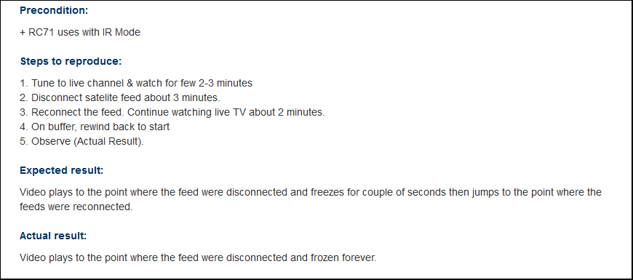
4. Case Study – Test data
SuperBlocker Issue
developer do a lot of analyze because they’re thinking it’s related to Hardware, CDI, etc..
Confidential
Page <number>

Slide 24
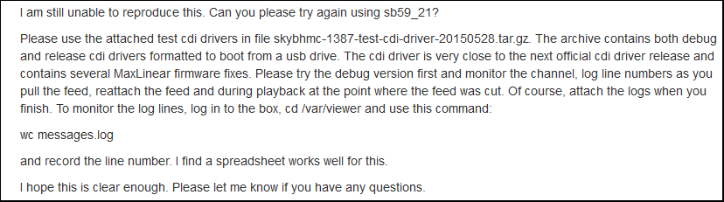
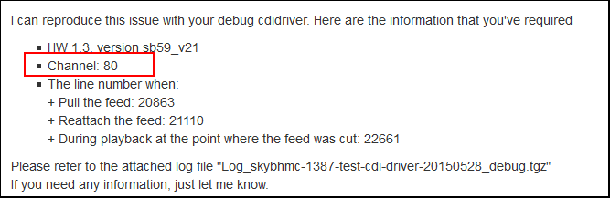
4. Case Study – Test data (Cont.)
But they still cannot reproduce with the local data
And here you are…
Confidential
Page <number>

Slide 25
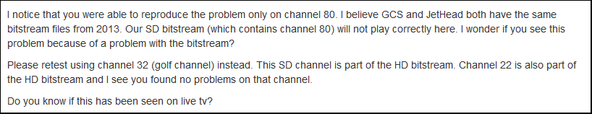
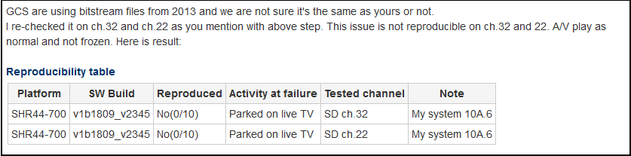
4. Case Study – Test data (Cont.)
May be this issue only happens on some particular channels
Confidential
Page <number>

Slide 26
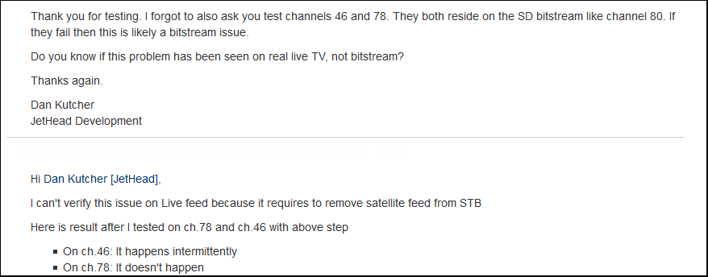
4. Case Study – Test data (Cont.)
This issue only happens only a set particular of channels and they need do more investigate
Confidential
Page <number>

Slide 27
5. Verifying
When
  The issue has been fixed and released for testing on the being test version
  New version has been launched, the opening issue was found in previous versions
How:
  Recheck the main scenario on happening environments and not happening environment
  Analyze the impact => do some regression test scenarios
  Add comment what you have done, what result you get
  Change status according to bug life cycle definition for that project
Confidential
Page <number>

Slide 28
6. Other operations
Add watcher
Link to another issue
Clone
….
Confidential
Page <number>

Slide 29

7. Experience/ Lession learn question/ sharing
Confidential
Page <number>

Slide 30

Ending
Confidential
Page <number>

Slide 31
Appendix_Bug samples for review/ revise
Please access to this link:
https://gcsjira.cybersoft-vn.com/wiki/display/TS/Training+materials => Extension courses: => Issue Report Workshop: IssueReport_Bug samples.doc
Confidential
Page <number>

